Slide 1
Writing book reviews and review articles
Professor Zhao Gang
Department of Translation, ECNU

Slide 2
Lecture outline
I. Publish in international journals: my own experience
II. Facts about book reviews
III. Facts about review articles
IV. How to write a book review or review article?
V. Address the reviewer’s questions for revision: my own experience
Appendices: How to contradict the peer-reviewer?

Slide 3
I. Publish in international journals: my own experience
1. Started to learn about International Journal of Lexicography, the best journal in my field of study.
2. Contacted the review editor in 2012 and received positive feedback, but failed to write one due to the Fulbright program.
3. Read a review in this journal in April, 2014, and decided to write one in August.
4. Finished the draft in two weeks and submitted it through email without asking for editor’s permission.
5. Was ALMOST refused two days later, but given a chance for revision following the suggestions of the review editor.
6. Finished and submitted the revision in two weeks, a total change of the structure, from 4000 words to 8000 words.
7. Accepted for revision several days later and started the one-month-long revision process, 8 revisions before finally accepted.

Slide 4
8. Asked the review editor to write the second review immediately after the acceptance of the first one, which, after 4 rounds of revision, finally turned into a review article.
9. Had the first one published in December 2014 and the second one published in March 2015.
10. Write the first article from April 2015 and finished the draft two months later. Submitted to IJL editor-in-chief, got the chance of peer-review, started revision, and got accepted in October, 2015. The article, which is more than 20,000 words in 38 pages, was published in December, 2016.
11. Asked to write the 3rd review at the end of 2015, finished the draft in one week, was accepted for published within a month, and published in June 2016.
12. Exploring Australian Journal of Linguistics in 2016, submitted two reviews one after another in the same year, got both published in 2017.

Slide 5
Several points of recognition:
1. Journal editors are trying their best to help the author to make their articles publishable.
2. Some editors are highly efficient and academically trained. They give very good suggestions for revision and the communicating processing is so enjoyable!
3. Writing for international journals is a great learning process that deserves everyone of us to have a try.
4. The ability to write in English is of paramount importance.
5. Be careful to ask native-speakers of English to revise your article. If they are not academics in your own field, they may do more bad than good.
6. Don’t lose contact with the editor after the acceptance of your first article. Try to propose more topics of academic interest and modestly ask for their suggestions. This may inspire you and give you chances to write new articles.

Slide 6
II. Facts about book reviews
1. A book review usually reviews a newly published academic work, or sometimes, an important academic work that has not been reviewed before. By newly published works, we mean works published 2-3 years ago or at most within 5 years.
2. Most international academic journals publish book reviews on a regular basis. Sometimes, they even devote a whole issue to book reviews.
3. Book reviews are often commissioned, i.e. the reviews editor invites someone to review a specific book he recommends. Most journals do not accept author’s own submissions.
4. Book reviews are usually short, about 2-8 pages or 2000-3000 English words. The shortest review can be only one page, while the longest one can be about 20 pages, as long as or even longer than an article, depending on the journal requirements.

Slide 7
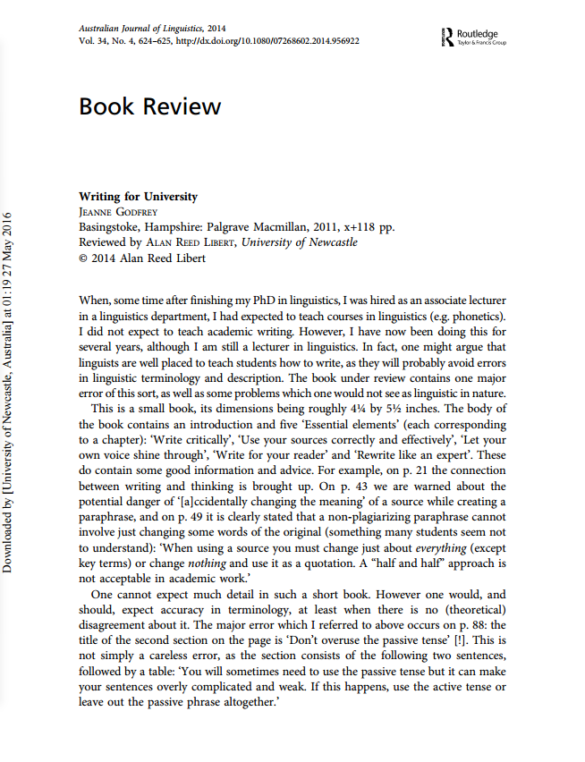
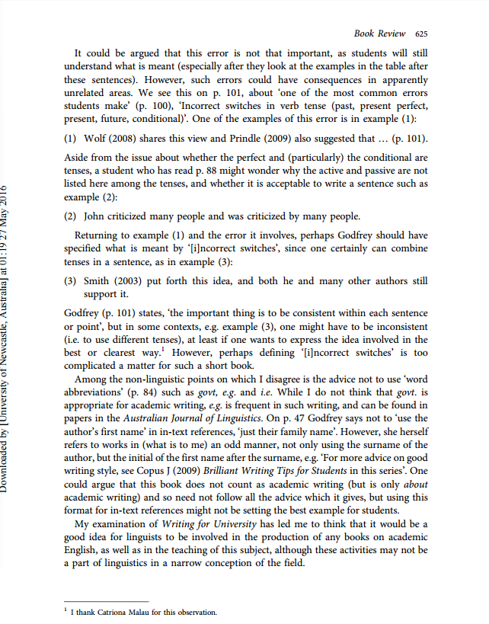

Slide 8
5. Books for review are often provided by publishers, for example, Oxford University Press provides to its journals new books for review and the review editors will find a suitable author to review them.
6. Conflict of interest: There should not be any conflict of interest between the reviewer and the book to be reviewed or the author of the book.

Slide 10
7. Book reviews can be critical or non-critical, depending on whether the reviewer likes or dislikes the book in question. Though most book reviews consists of both praise and criticism, some may be highly critical.

Slide 11
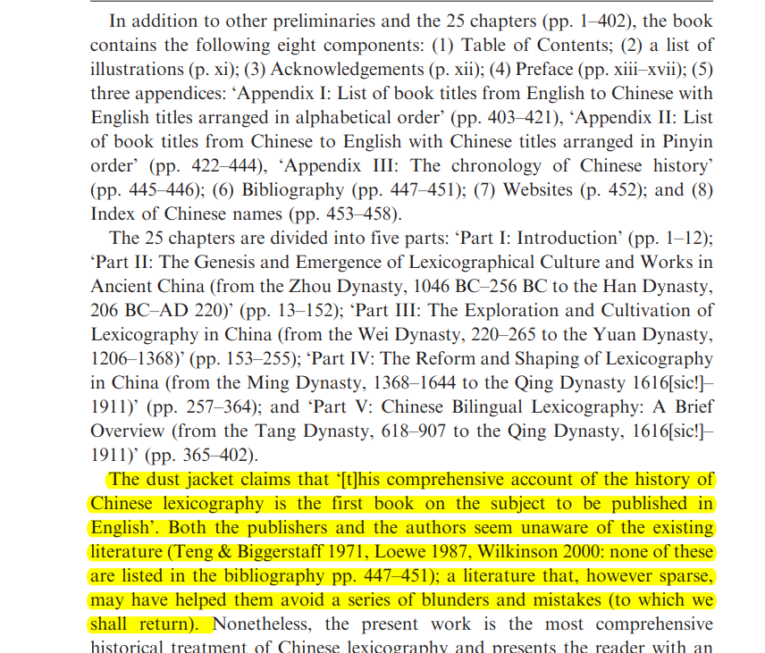
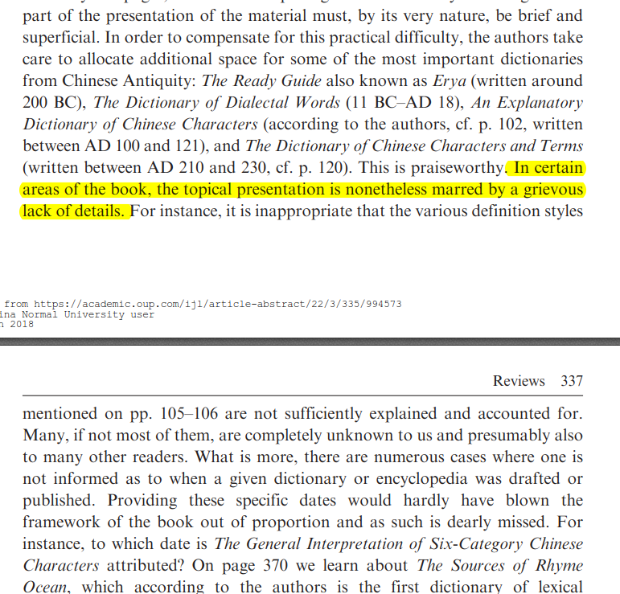

Slide 12
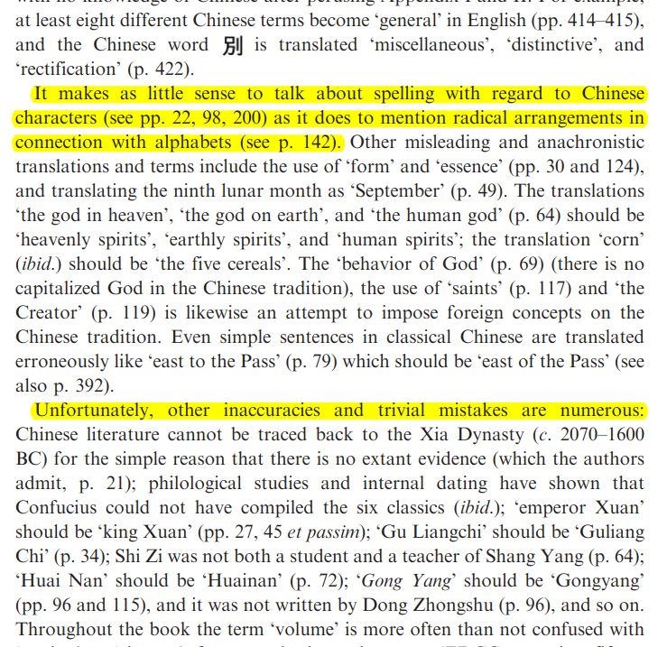
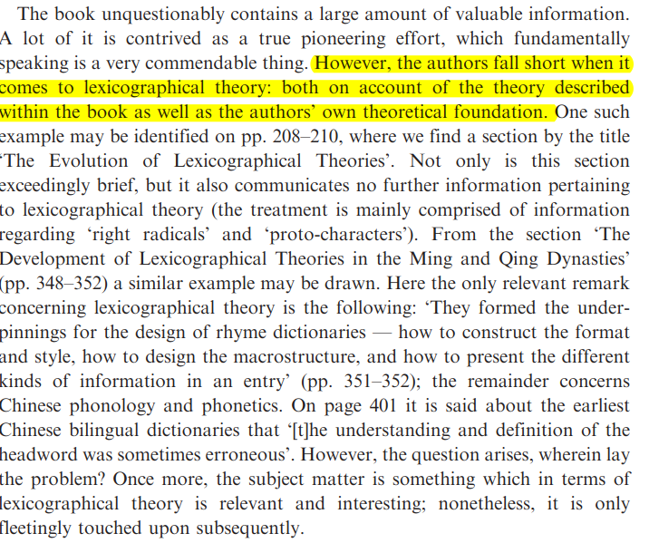

Slide 13
8. Book reviews in Chinese academic journals VS books reviews in international journals
(1) overpraise VS objective
(2) conflict of interest VS no conflict of interest
(3) peripheral VS important
(4) descriptive VS critical
(5) rarity VS abundance
……
9. Book reviews can be with or without references or bibliography.
10. Book reviews are often not peer-reviewed. The reviews editor may revise the review as they see fit, especially when it is written by non-native speakers of English.

Slide 14
III. Facts about review articles
1. A review article is an article that summarizes the current state of understanding on a topic. A review article surveys and summarizes previously published studies, rather than reporting new facts or analysis. Academic publications that specialize in review articles are known as review journals.
Review articles teach about:
the main people working in a field
recent major advances and discoveries
significant gaps in the research
current debates
ideas of where research might go next

Slide 15
2. Review articles analyze or discuss research previously published by others, rather than reporting new experimental results. An expert's opinion is valuable, but an expert's assessment of the literature can be more valuable. Readers benefit from the expert's explanation and assessment of the validity and applicability of individual studies.
3. Review articles come in the form of literature reviews and, more specifically, systematic reviews; both are a form of secondary literature. Literature reviews provide a summary of what the authors believe are the best and most relevant prior publications. Systematic reviews determine an objective list of criteria, and find all previously published original experimental papers that meet the criteria; they then compare the results presented in these papers.
4. It is possible for a review article itself to be peer-reviewed or non-peer-reviewed.

Slide 16
5. A review article is often commissioned, written by well-known figures in a certain field, but well-written review articles by young scholars also have the chance of being accepted.
6. A review article often reviews more than one book or studies; it can also be review of one work, if this work shows not only the status quo of the current studies but also pinpoints gaps in current research and ideas of where research might go next.

Slide 17
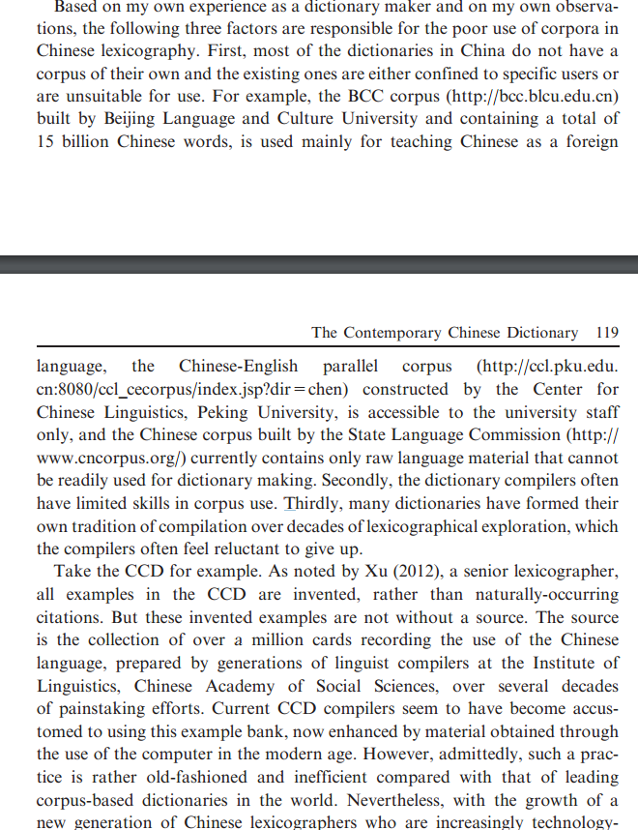

Slide 18
IV. How to write a book review or review article?
Step 1
Choose a good work/good works to review. Recently-published, academically important, representative of a research field, unreviewed
Step 2
Choose the right journal to submit your review to; get familiarized with the journal style and requirements.
Step 3
Contact the reviews editor
Introduce the work in detail, focusing on its academic importance.
Ask for the permission to review.
Be polite in wording and respect the editor.

Slide 19
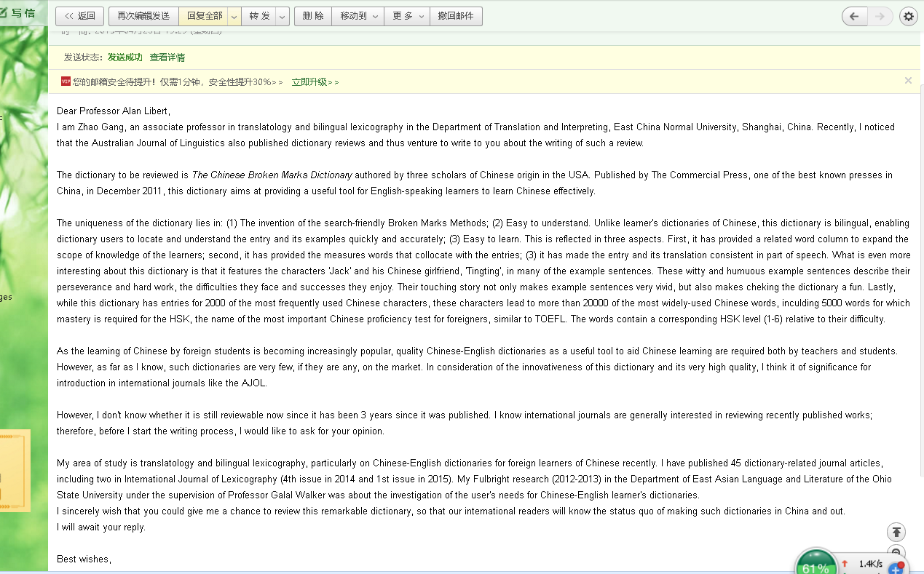

Slide 21
Step 4
1. Upon permission, read the book carefully and, most important, critically, summarize its strengths and weaknesses against one or more established criteria in the field, and note down the strengths and weaknesses categorically.
2. Describe the strengths with good examples and analyze the weaknesses convincingly based on sound theories.

Slide 23
3. Write the review/review article: demonstrate your ability to write in English and your logical and critical thinking.
(1) Use plain English: Be concise, logic, and to the point; avoid lengthy sentences, paragraphs without a topic sentence, false starters, passivity, and stupid grammar mistakes that ruin your image as a good writer immediately.
(2) Try write interestingly if possible: Remember to hook your readers’ attention even in academic writing. Use interesting examples, strong verbs, and vary your sentence lengths and types to boost the expressiveness of your writing. Avoid decoration!!
(3) Be proportionate: Generally, give more space to the strengths if you like the book, but remember to mention its weaknesses at the end. No book is perfect. However, if you don’t like the book, you can briefly mention its strong points in the beginning if it has some, and then devote the rest of your review to criticism.

Slide 24
(4) Make your writing hierarchical: use subtitles in a long review or review article; use transitional words for orders, such as first, second, third, etc., in a short review.
(5) Don’t forget to clarify your view again in the last paragraph or paragraphs.
(6) Be objective and restrained in your evaluation and never get emotional.

Slide 25
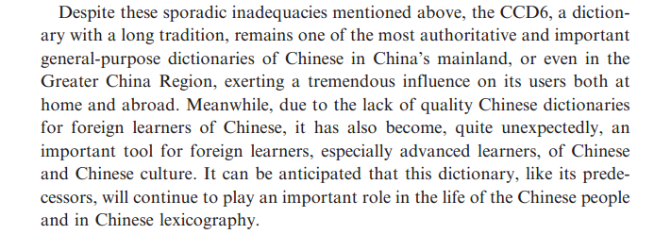

Slide 26
Step 5
Revise your work again and again based on the editor’s feedback until it becomes suitable for publication.

Slide 27
Overall, follow the 10 “Bs”:
Be familiar with the journal you are going to submit your review to,
Be courageous to contact the reviews editor,
Be detailed in introducing the book to be reviewed,
Be critical in reading the book to be reviewed,
Be convincing in reasoning,
Be theoretical in analysis,
Be research-based in making compliments or criticism,
Be professional and academic in writing: logical, concise and reader-centered,
Be objective in making evaluations,
Be careful not to get emotional or fall into personal attack.

Slide 28
V. Address the reviewer’s questions for revision: my own experience
The reviewer’s questions for revision vary based on the quality of your review. Following is part of my own experience with Review of New Age Chinese-English Dictionary (2nd Edition, 2014).

Slide 29
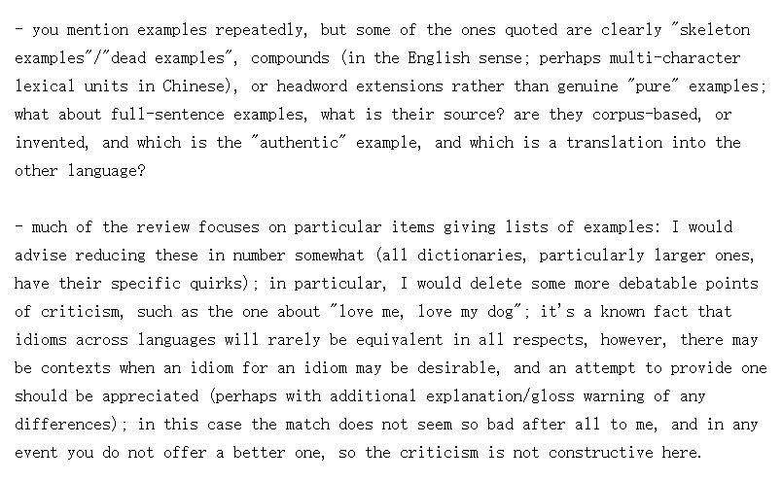

Slide 33
A summary:
1. Take the editor’s questions seriously and address them ONE BY ONE!
2. You may contradict some of the editor’s views, but do show good reasons and politeness.
3. Address the questions as detailedly as possible and make every effort to convince the editor.
4. Regarding questions put forward by peer-reviewers, aim at solving the questions, not at the peer-reviewer. Believe the editor. He can often serve a good judge when controversies arise between you and peer-reviewer.
5. Never stop sharpening your English!

Slide 35
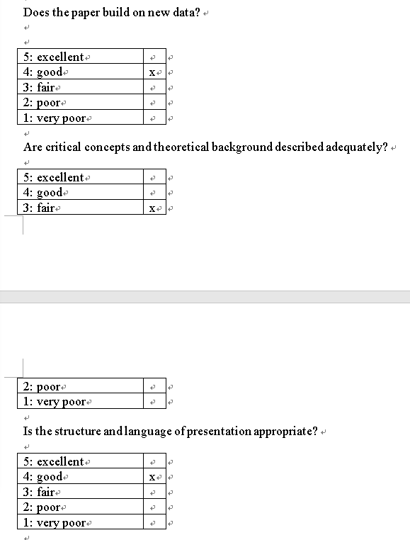

Slide 38
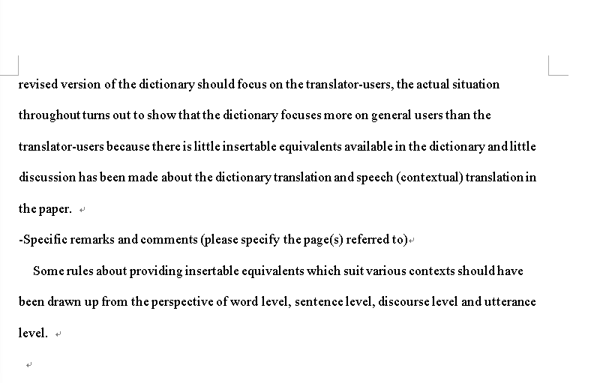

Slide 41
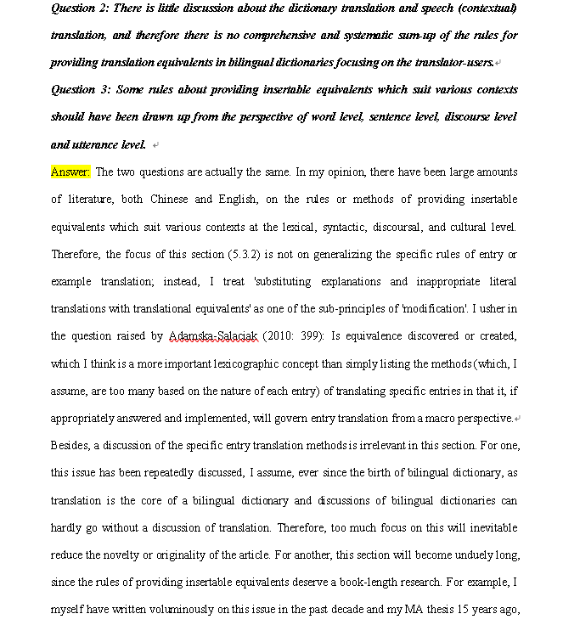

Slide 44
Thanks!

